Slide 1
Intent and Intent Filter
Part of the sources for the following slides from developer.android.com

Slide 2
Intent
An Intent is a messaging object you can use to request an action from another app component.
Three main purposes for Intent
  To start an activity
    You can start a new instance of an Activity by passing an Intent to startActivity(). The Intent describes the activity to start and carries any necessary data.
  To start a service
    You can start a service to perform a one-time operation (such as download a file) by passing an Intent to startService(). The Intent describes the service to start and carries any necessary data.
  To deliver a broadcast
    You can deliver a broadcast to other apps by passing an Intent to sendBroadcast(), sendOrderedBroadcast(), or sendStickyBroadcast().

Slide 3
Intent Types
Explicit intents
  Specify the component to start by name (the fully-qualified class name). You'll typically use an explicit intent to start a component in your own app, because you know the class name of the activity or service you want to start. For example, start a new activity in response to a user action or start a service to download a file in the background.
Implicit intents
  Do not name a specific component, but instead declare a general action to perform, which allows a component from another app to handle it. For example, if you want to show the user a location on a map, you can use an implicit intent to request that another capable app show a specified location on a map. Normally, intent filter is needed.

Slide 4
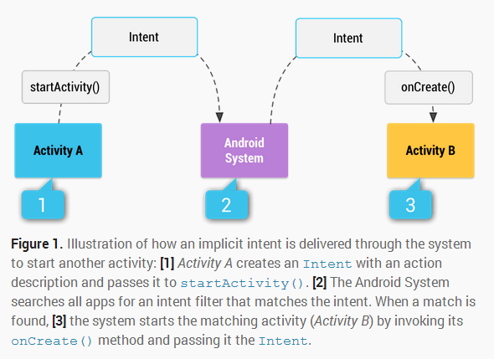
Intent

Slide 5
Intent
When you create an explicit intent to start an activity or service, the system immediately starts the app component specified in the Intent object.
When you create an implicit intent, the Android system finds the appropriate component to start by comparing the contents of the intent to the intent filters declared in the manifest file of other apps on the device.
If the intent matches an intent filter, the system starts that component and delivers it the Intent object.
If multiple intent filters are compatible, the system displays a dialog so the user can pick which app to use.
An intent filter is an expression in an app's manifest file that specifies the type of intents that the component would like to receive.

Slide 6
Building an Intent
An Intent object carries information that the Android system uses to determine which component to start(such as the exact component name or component category that should receive the intent), plus information that the recipient component uses in order to properly perform the action (such as the action to take and the data to act upon).
The primary information contained in an Intent is the following:
  Component Name
  Action
  Data
  Category
  Extras
  Flags

Slide 7
Building an Intent ---Component Name
The name of the component to start. (Optional)
It's the critical piece of information that makes an intent explicit.
Without a component name, the intent is implicit and the system decides which component should receive the intent based on the other intent information .
This field of the Intent is a ComponentName object, which you can specify using a fully qualified class name of the target component, including the package name of the app.
  For example, com.example.ExampleActivity. You can set the component name with setComponent(),setClass(), setClassName(), or with the Intent constructor.

Slide 8
Building an Intent---Action
A string that specifies the generic action to perform (such as view or pick).
In the case of a broadcast intent, this is the action that took place and is being reported. The action largely determines how the rest of the intent is structured—particularly what is contained in the data and extras.
You can specify your own actions for use by intents within your app, but you should usually use action constants defined by the Intent class or other framework classes.
ACTION_VIEW
  Use this action in an intent with startActivity() when you have some information that an activity can show to the user, such as a photo to view in a gallery app, or an address to view in a map app.

Slide 9
Building an Intent---Action
ACTION_SEND
  Also known as the "share" intent, you should use this in an intent with startActivity() when you have some data that the user can share through another app, such as an email app or social sharing app.
You can specify the action for an intent with setAction() or with an Intent constructor.

Slide 10
Building an Intent---Data
The URI (a Uri object) that references the data to be acted on and/or the MIME type of that data. The type of data supplied is generally dictated by the intent's action. For example, if the action is ACTION_EDIT, the data should contain the URI of the document to edit.
When creating an intent, it's often important to specify the type of data (its MIME type) in addition to its URI.
  For example, an activity that's able to display images probably won't be able to play an audio file, even though the URI formats could be similar.
To set only the data URI, call setData(). To set only the MIME type, call setType(). If necessary, you can set both explicitly with setDataAndType().
MIME stands for Multi-purpose Internet Mail Extensions. MIME types form a standard way of classifying file types on the Internet. A MIME type has two parts: a type and a subtype. They are separated by a slash (/).
For example, the MIME type for Microsoft Word files is application and the subtype is msword. Together, the complete MIME type is application/msword.

Slide 11
Building an Intent---Category
A string containing additional information about the kind of component that should handle the intent.
Any number of category descriptions can be placed in an intent, but most intents do not require a category. Here are some common categories:
  CATEGORY_BROWSABLE
    The target activity allows itself to be started by a web browser to display data referenced by a link—such as an image or an e-mail message.
  CATEGORY_LAUNCHER
    The activity is the initial activity of a task and is listed in the system's application launcher.

Slide 12
Building an Intent---Extras
Key-value pairs that carry additional information required to accomplish the requested action. Just as some actions use particular kinds of data URIs, some actions also use particular extras.
You can add extra data with various putExtra() methods, each accepting two parameters: the key name and the value. You can also create a Bundle object with all the extra data, then insert the Bundle in the Intent with putExtras().
For example, when creating an intent to send an email with ACTION_SEND, you can specify the "to" recipient with the EXTRA_EMAIL key, and specify the "subject" with the EXTRA_SUBJECT key.

Slide 13
Building an Intent---Flags
Flags defined in the Intent class that function as metadata for the intent.
The flags may instruct the Android system how to launch an activity (for example, which task the activity should belong to) and how to treat it after it's launched (for example, whether it belongs in the list of recent activities).

Slide 14
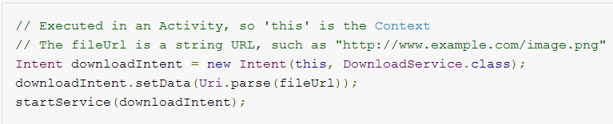
Example of Explicit Intent
An explicit intent is one that you use to launch a specific app component, such as a particular activity or service in your app.
To create an explicit intent, define the component name for the Intent object—all other intent properties are optional.
For example, if you built a service in your app, named DownloadService, designed to download a file from the web, you can start it with the following code:

Slide 15
Example of Implicit Intent
An implicit intent specifies an action that can invoke any app on the device able to perform the action.
Using an implicit intent is useful when your app cannot perform the action, but other apps probably can and you'd like the user to pick which app to use.
For example, if you have content you want the user to share with other people, create an intent with the ACTION_SEND action and add extras that specify the content to share. When you call startActivity() with that intent, the user can pick an app through which to share the content.
To verify that an activity will receive the intent, call resolveActivity() on your Intent object. Else your apps will crash if user not able to handle your intent.

Slide 16
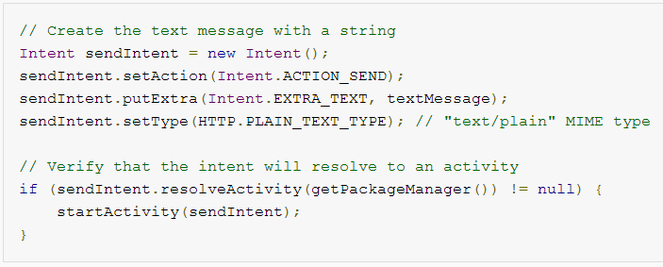
Example of Implicit Intent

Slide 17
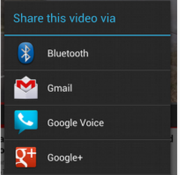
Forcing an app chooser
When there is more than one app that responds to your implicit intent, the user can select which app to use and make that app the default choice for the action.
If multiple apps can respond to the intent and the user might want to use a different app each time, you should explicitly show a chooser dialog.

Slide 18
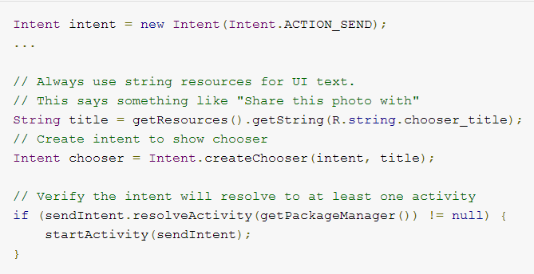
Forcing an app chooser
To show the chooser, create an Intent using createChooser() and pass it to startActivity(). For example:

Slide 19
Receiving an Implicit Intent
To advertise which implicit intents your app can receive, declare one or more intent filters for each of your app components with an <intent-filter> element in your manifest file.
Each intent filter specifies the type of intents it accepts based on the intent's action, data, and category. The system will deliver an implicit intent to your app component only if the intent can pass through one of your intent filters.
An app component should declare separate filters for each unique job it can do.
For example, one activity in an image gallery app may have two filters: one filter to view an image, and another filter to edit an image.

Slide 20
Receiving an Implicit Intent
Each intent filter is defined by an <intent-filter> element in the app's manifest file, nested in the corresponding app component (such as an <activity> element).
Inside the <intent-filter>, you can specify the type of intents to accept using one or more of these three elements:
<action>
  Declares the intent action accepted, in the name attribute. The value must be the literal string value of an action, not the class constant.
<data>
  Declares the type of data accepted, using one or more attributes that specify various aspects of the data URI (scheme, host, port, path, etc.) and MIME type.
<category>
  Declares the intent category accepted, in the name attribute. The value must be the literal string value of an action, not the class constant.

Slide 21
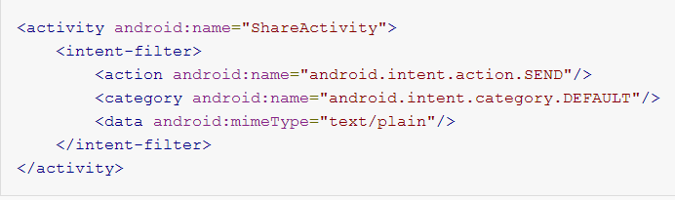
Receiving an Implicit Intent
In order to receive implicit intents, you must include the CATEGORY_DEFAULT category in the intent filter.
The methods startActivity() and startActivityForResult() treat all intents as if they declared the CATEGORY_DEFAULT category.
If you do not declare this category in your intent filter, no implicit intents will resolve to your activity.

Slide 22
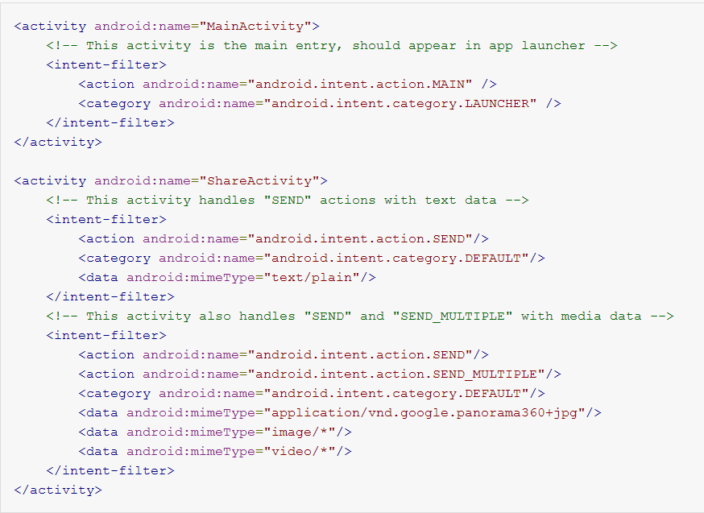
Example of filters

Slide 23
Example of filters
The first activity, MainActivity, is the app's main entry point— the activity that opens when the user initially launches the app with the launcher icon:
  The ACTION_MAIN action indicates this is the main entry point and does not expect any intent data.
  The CATEGORY_LAUNCHER category indicates that this activity's icon should be placed in the system's app launcher. If the <activity> element does not specify an icon with icon, then the system uses the icon from the <application> element.
The second activity, ShareActivity, is intended to facilitate sharing text and media content.

Slide 24
Using a Pending Intent
A Pending Intent object is a wrapper around an Intent object.
The primary purpose of a Pending Intent is to grant permission to a foreign application to use the contained Intent as if it were executed from your app's own process.
Major use cases for a pending intent include:
  Declare an intent to be executed when the user performs an action with your Notification (the Android system‘s NotificationManager executes the Intent).
  Declare an intent to be executed when the user performs an action with your App Widget (the Home screen app executes the Intent).
  Declare an intent to be executed at a specified time in the future (the Android system's AlarmManager executes the Intent).

Slide 25
Using a Pending Intent
When using a pending intent, your app will not execute the intent with a call such as startActivity().
You must instead declare the intended component type when you create the PendingIntent by calling the respective creator method:
PendingIntent.getActivity() for an Intent that starts an Activity.
PendingIntent.getService() for an Intent that starts a Service.
PendingIntent.getBroadcast() for a Intent that starts an BroadcastReceiver.

Slide 26
Intent Resolution
When the system receives an implicit intent to start an activity, it searches for the best activity for the intent by comparing the intent to intent filters based on three aspects:
  The intent action
  The intent data (both URI and data type)
  The intent category

Slide 27
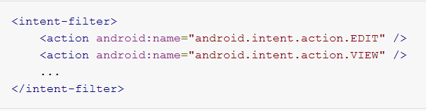
Intent Resolution---Action Test
To specify accepted intent actions, an intent filter can declare zero or more <action> elements. For example:
To get through this filter, the action specified in the Intent must match one of the actions listed in the filter.
If the filter does not list any actions, there is nothing for an intent to match, so all intents fail the test.

Slide 28
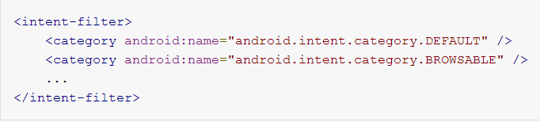
Intent Resolution---Category Test
To specify accepted intent categories, an intent filter can declare zero or more <category> elements. For example:
For an intent to pass the category test, every category in the Intent must match a category in the filter. The reverse is not necessary—the intent filter may declare more categories than are specified in the Intent and the Intent will still pass.

Slide 29
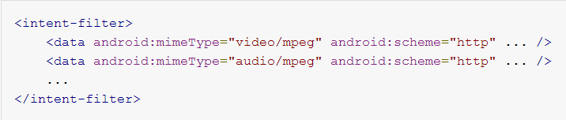
Intent Resolution---Data Test
To specify accepted intent data, an intent filter can declare zero or more <data> elements. For example:
Each <data> element can specify a URI structure and a data type (MIME media type). There are separate attributes — scheme, host, port, and path — for each part of the URI:
<scheme>://<host>:<port>/<path>
For example:
content://com.example.project:200/folder/subfolder/etc
In this URI, the scheme is content, the host is com.example.project, the port is 200, and the path isfolder/subfolder/etc.

Slide 30
Intent Resolution---Data Test
Each of these attributes is optional in a <data> element, but there are linear dependencies:
  If a scheme is not specified, the host is ignored.
  If a host is not specified, the port is ignored.
  If both the scheme and host are not specified, the path is ignored.
When the URI in an intent is compared to a URI specification in a filter, it's compared only to the parts of the URI included in the filter.
  If a filter specifies only a scheme, all URIs with that scheme match the filter.
  If a filter specifies a scheme and an authority but no path, all URIs with the same scheme and authority pass the filter, regardless of their paths.
  If a filter specifies a scheme, an authority, and a path, only URIs with the same scheme, authority, and path pass the filter.

Slide 31
Intent Resolution---Data Test
The data test compares both the URI and the MIME type in the intent to a URI and MIME type specified in the filter. The rules are as follows:
  An intent that contains neither a URI nor a MIME type passes the test only if the filter does not specify any URIs or MIME types.
  An intent that contains a URI but no MIME type (neither explicit nor inferable from the URI) passes the test only if its URI matches the filter's URI format and the filter likewise does not specify a MIME type.

Slide 32
Intent Resolution---Data Test
An intent that contains a MIME type but not a URI passes the test only if the filter lists the same MIME type and does not specify a URI format.
An intent that contains both a URI and a MIME type (either explicit or inferable from the URI) passes the MIME type part of the test only if that type matches a type listed in the filter. It passes the URI part of the test either if its URI matches a URI in the filter or if it has a content: or file: URI and the filter does not specify a URI. In other words, a component is presumed to support content: and file: data if its filter lists only a MIME type.

Slide 33
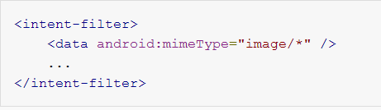
Intent Resolution---Data Test
A <data> element like the following, for example, tells Android that the component can get image data from a content provider and display it:
Because most available data is dispensed by content providers, filters that specify a data type but not a URI are perhaps the most common.

Slide 34
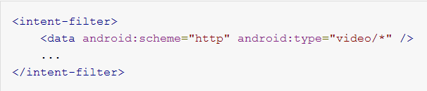
Intent Resolution---Data Test
For example, a <data> element like the following tells Android that the component can retrieve video data from the network in order to perform the action:

Slide 35
Intent matching
Intents are matched against intent filters not only to discover a target component to activate, but also to discover something about the set of components on the device.
For example, the Home app populates the app launcher by finding all the activities with intent filters that specify the ACTION_MAIN action and CATEGORY_LAUNCHER category.

Slide 36
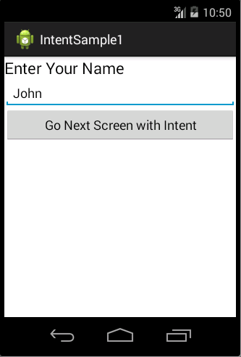
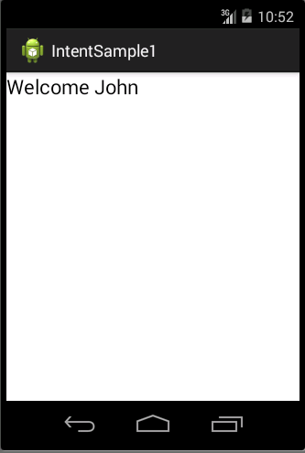
Example 1(Explicit)

Slide 37
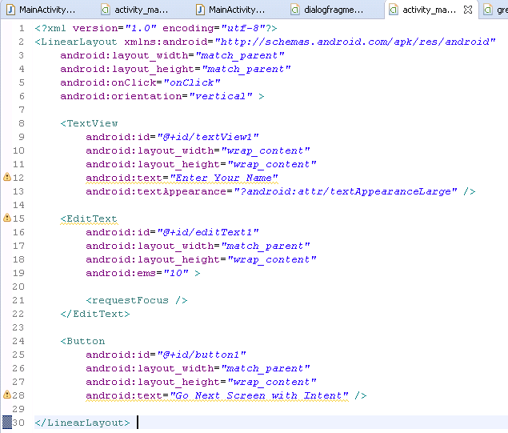
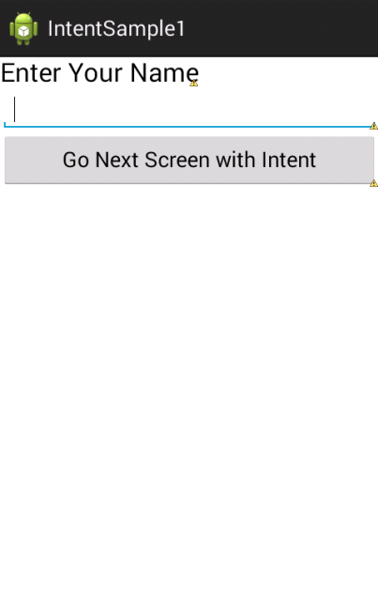
Activity_main.xml

Slide 38
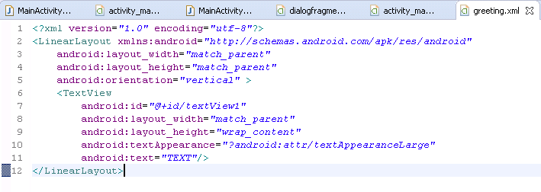
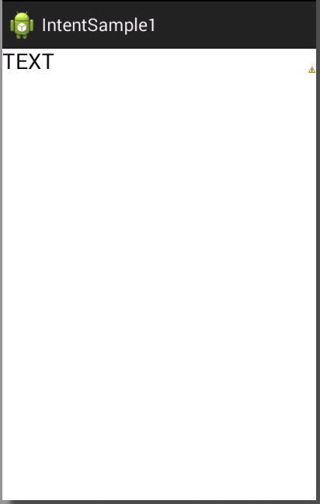
Greeting.xml

Slide 39
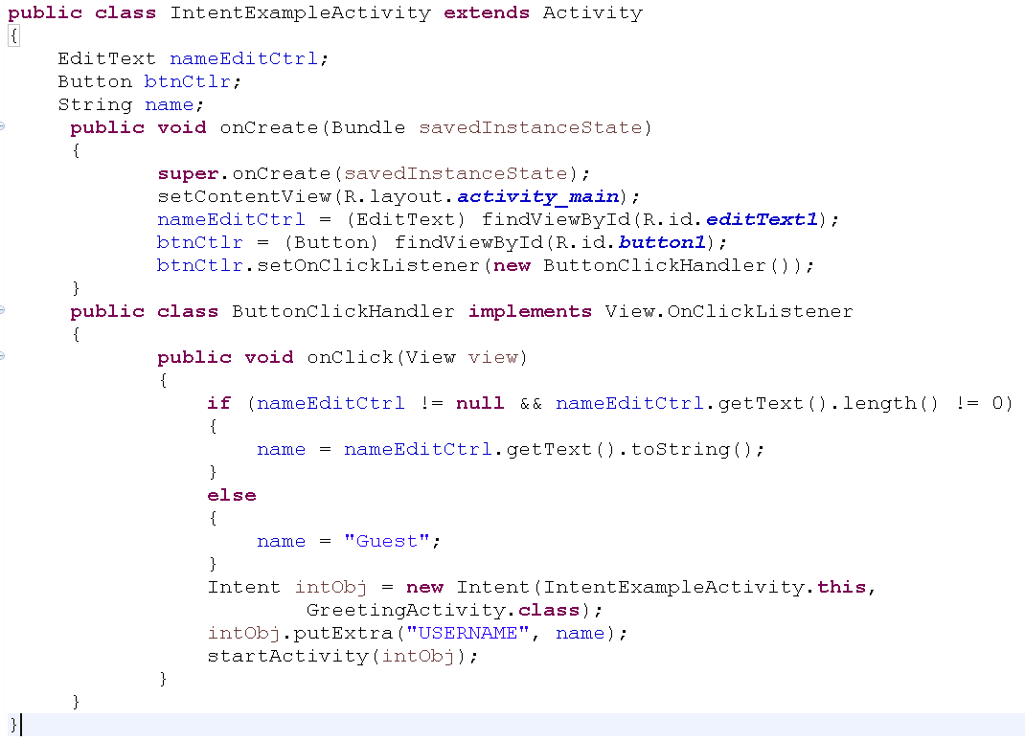
IntentExampleActivity.java

Slide 40
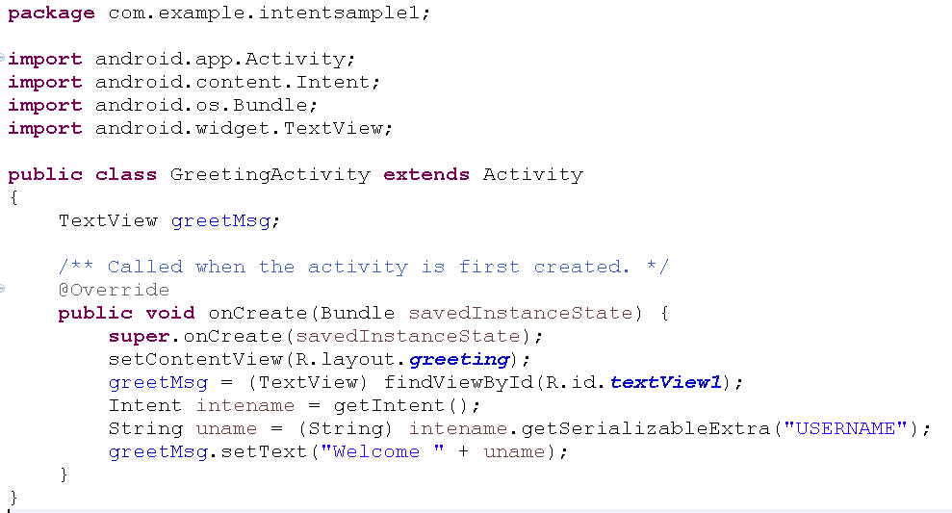
GreetingActivity.xml

Slide 41
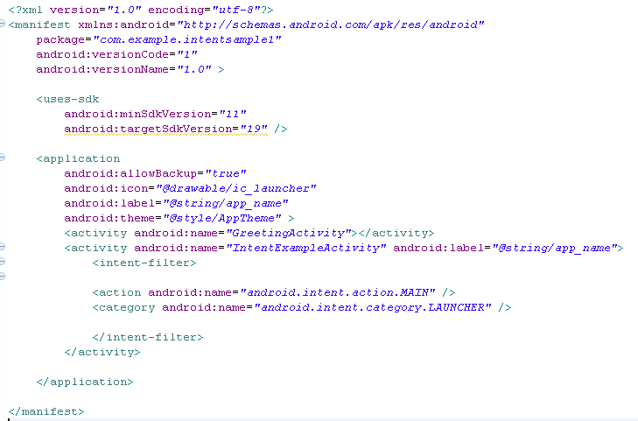
AndroidManifest.xml

Slide 42
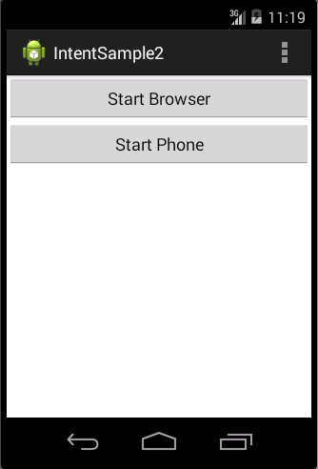
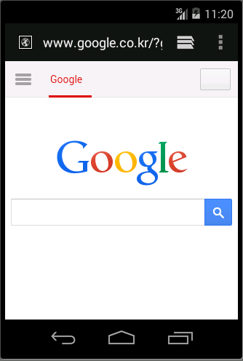
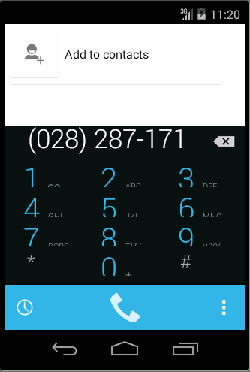
Example 2(Implicit)

Slide 43
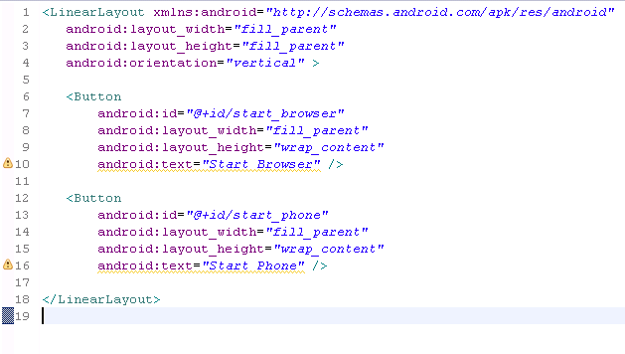
Activity_main.xml

Slide 44
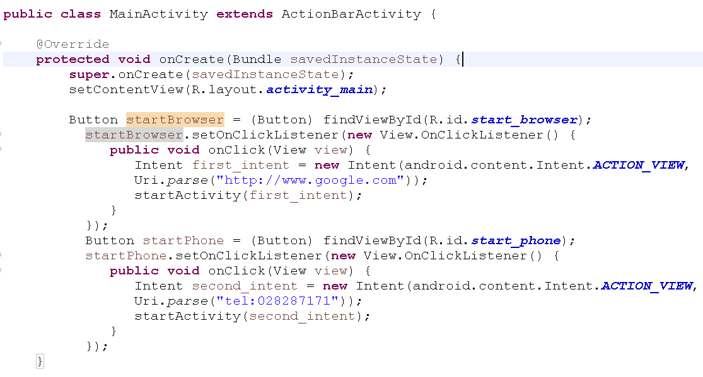
MainActivity.java

Slide 45
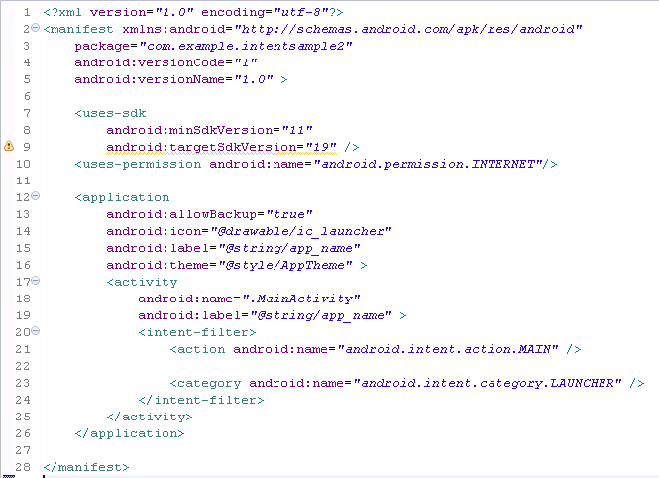
AndroidManifest.xml

